Slide 1



Face Mask Detection
By :- Ayush Mehta

Slide 2

Purpose of the model
Considering the covid-19 outbreak, I think this is best project that I can work as a Machine Learning enthusiast. Today everyone is aware of taking precaution and safety measures regarding covid-19, so face mask detection will play a huge role to avoid corona virus.
This project helps us to spread the awareness among people using face mask properly. It detects the face mask on your face whether the person is hiding his/her face by mask or not.

Slide 3
Introduction
The face mask detector will help detecting whether a person is wearing mask or not.
To predict we need to create a ML model using neural networks.
Using OpenCV we will take input from a webcam and inserting it into the model which will then predict.
To perform Face mask detection, some basic knowledge on neural network, Computer Vesion, OpenCV and image processing is needed.

Slide 4
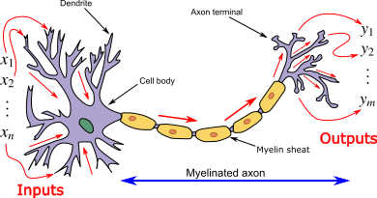
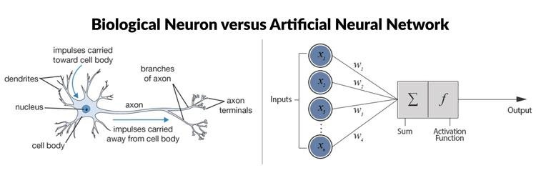
Artificial Neural Network (ANN)
An artificial neural network (ANN) is the piece of a computing system designed to simulate the way the human brain analyses and processes information.
An ANN is based on a collection of connected units or nodes called artificial neuron, which loosely model the neurons in a biological brain.

Slide 5
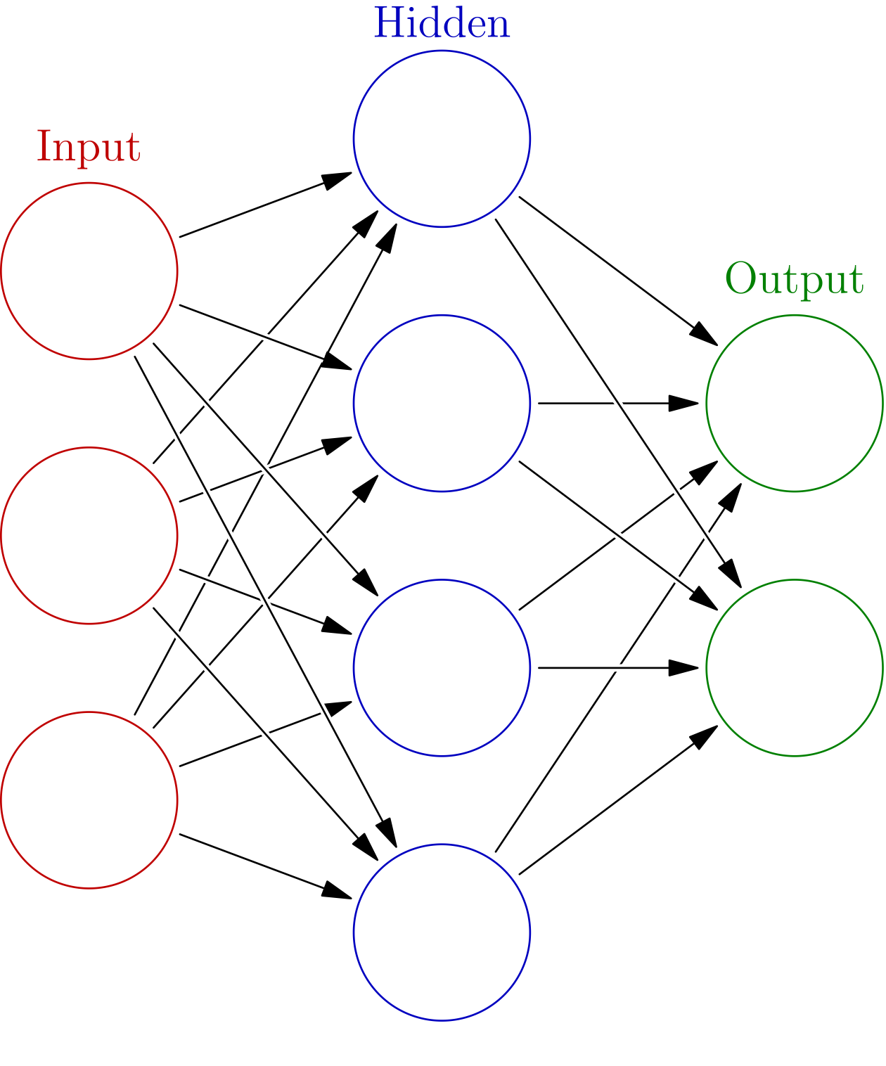
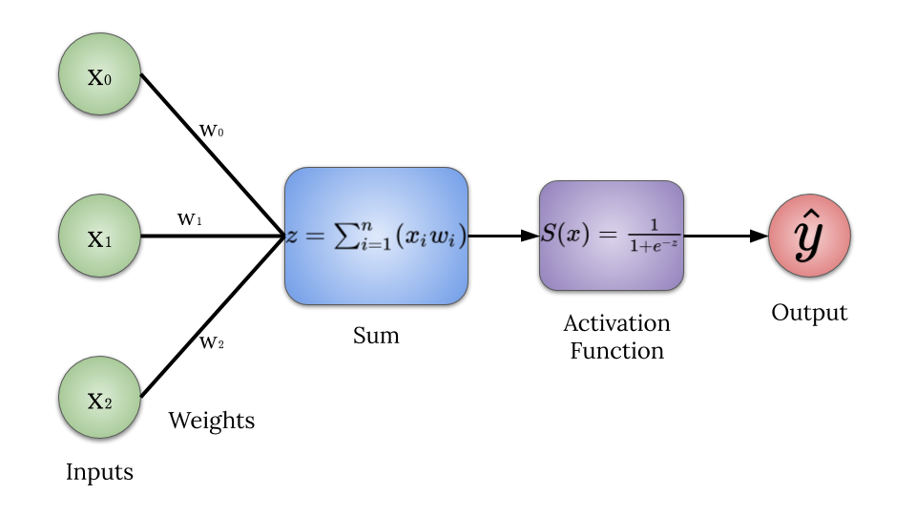
Components of ANN
Neurons :- Each artificial neuron has inputs and produces a single output which can be sent to multiple other neurons. The inputs can be the feature values of a sample of external data, such as images or documents, or they can be the outputs of other neurons. The outputs of the final output neurons of the neural net accomplish the task, such as recognizing an object in an image.
Connections and weights :- The network consists of connections, each connection providing the output of one neuron as an input to another neuron. Each connection is assigned a weight that represents its relative importance. A given neuron can have multiple input and output connections.
Propagation function:- The propagation function computes the input to a neuron from the outputs of its predecessor neurons and their connections as a weighted sum. A bias term can be added to the result of the propagation.

Slide 6

Convolution Neural Network (CNN)
In deep learning, a convolutional neural network (CNN, or ConvNet) is a class of deep neural network, most commonly applied to analysing visual imagery.

Slide 7
Convolution Layers
There are three types of layers that make up the CNN which are the convolutional layers, pooling layers, and fully-connected (FC) layers. When these layers are stacked, a CNN architecture will be formed. In addition to these three layers, there are two more important parameters which are the dropout layer and the activation function.
Layers of CNN:-
1.Convolution layers
2.Pooling layers
3.Fully-connected layers

Slide 8
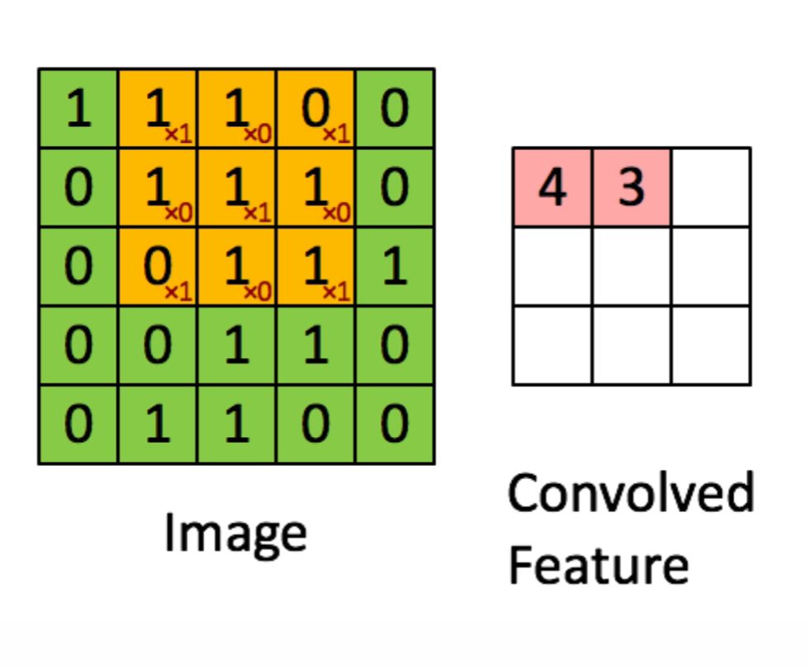
1.Convolution layers
This layer is the first layer that is used to extract the various features from the input images. In this layer, the mathematical operation of convolution is performed between the input image and a filter of a particular size MxM. By sliding the filter over the input image, the dot product is taken between the filter and the parts of the input image with respect to the size of the filter (MxM).
The output is termed as the Feature map which gives us information about the image such as the corners and edges. Later, this feature map is fed to other layers to learn several other features of the input image.
Image Dimensions = 5 (Height) x 5 (Breadth) x 1 (Number of channels, example: RGB)
In the above demonstration, the green section resembles our 5x5x1 input image, I. The element involved in carrying out the convolution operation in the first part of a Convolutional Layer is called the Kernel/Filter, K, represented in the colour yellow. We have selected K as a 3x3x1 matrix.

Slide 9
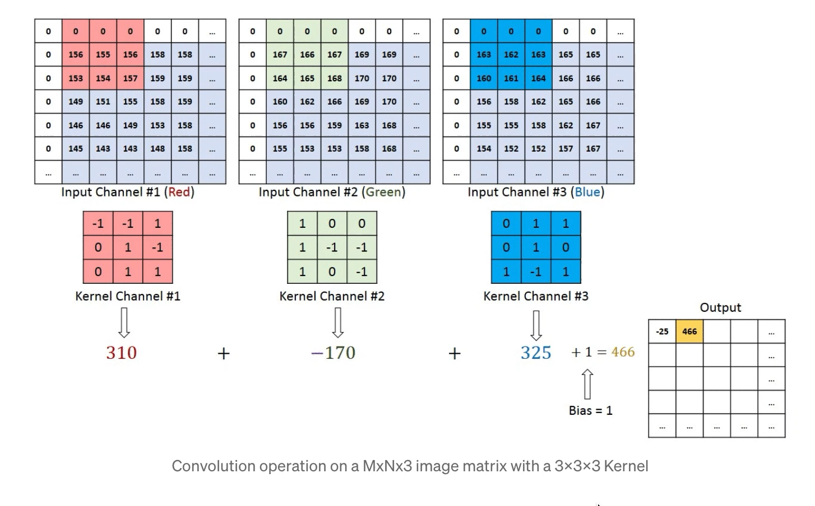
In the case of images with multiple channels (e.g. RGB), the Kernel has the same depth as that of the input image. Matrix Multiplication is performed between Kn and In stack ([K1, I1]; [K2, I2]; [K3, I3]) and all the results are summed with the bias to give us a squashed one-depth channel Convoluted Feature Output.

Slide 10
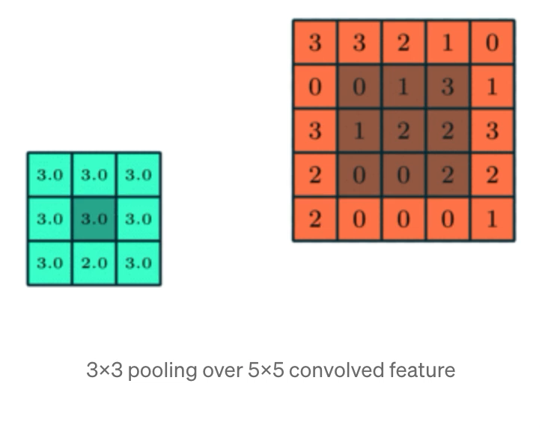

2.Pooling layers
In most cases, a Convolutional Layer is followed by a Pooling Layer. The primary aim of this layer is to decrease the size of the convolved feature map to reduce the computational costs. This is performed by decreasing the connections between layers and independently operates on each feature map. Depending upon method used, there are several types of Pooling operations.
In Max Pooling, the largest element is taken from feature map. Average Pooling calculates the average of the elements in a predefined sized Image section.

Slide 11
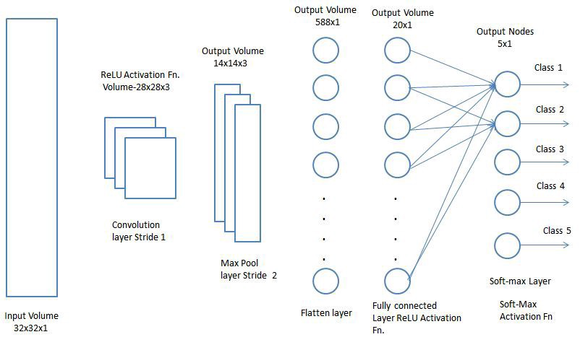
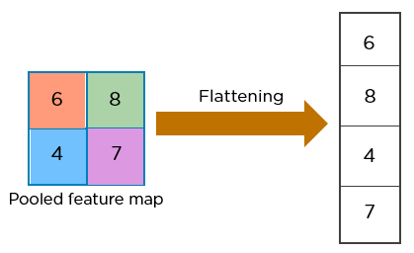
3.Fully-connected layers
The Fully Connected (FC) layer consists of the weights and biases along with the neurons and is used to connect the neurons between two different layers. These layers are usually placed before the output layer and form the last few layers of a CNN Architecture.
In this, the input image from the previous layers are flattened and fed to the FC layer.

Slide 12
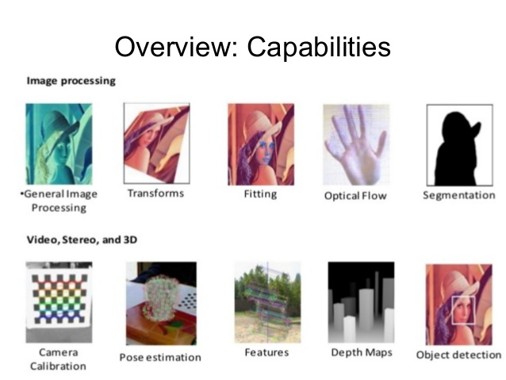
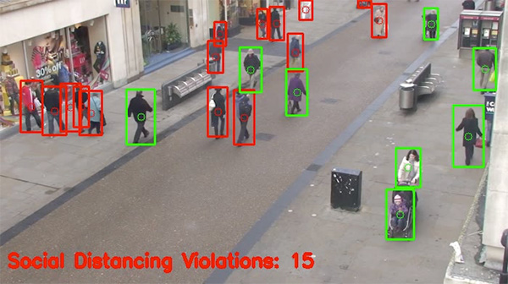
OpenCV
OpenCV is a library of programming functions mainly aimed at real-time computer vision.
Originally developed by Intel, it was later supported by Willow Garage then Itseez.

Slide 13
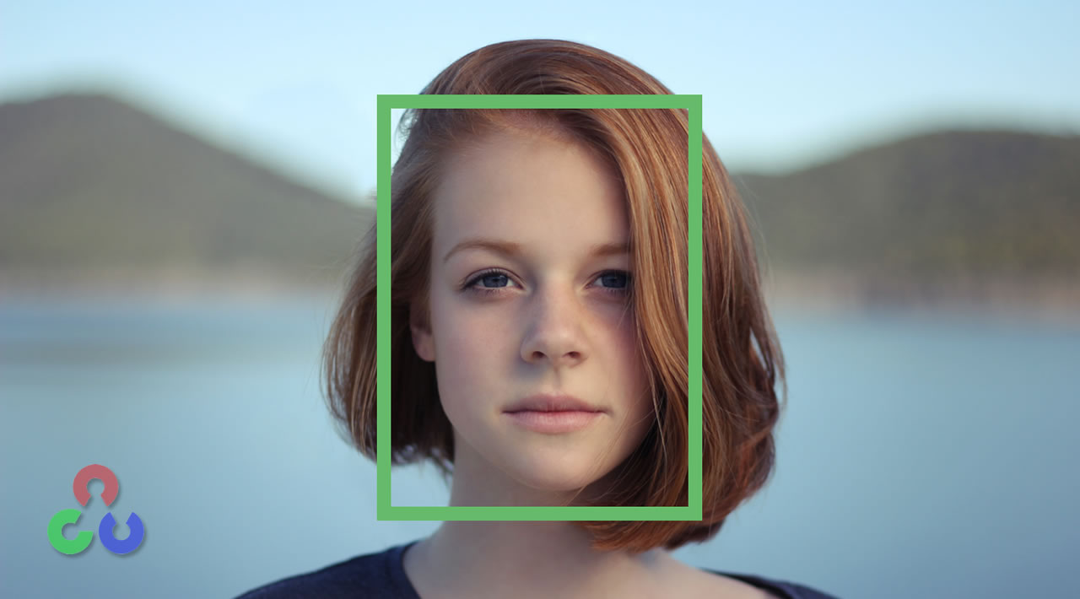
Face Detection using OpenCV
Face detection using Haar cascades is a machine learning based approach where a cascade function is trained with a set of input data.
OpenCV already contains many pre-trained classifiers for face, eyes, smiles, etc..
Using Haar cascades we will detect the faces from the webcam input.

Slide 14
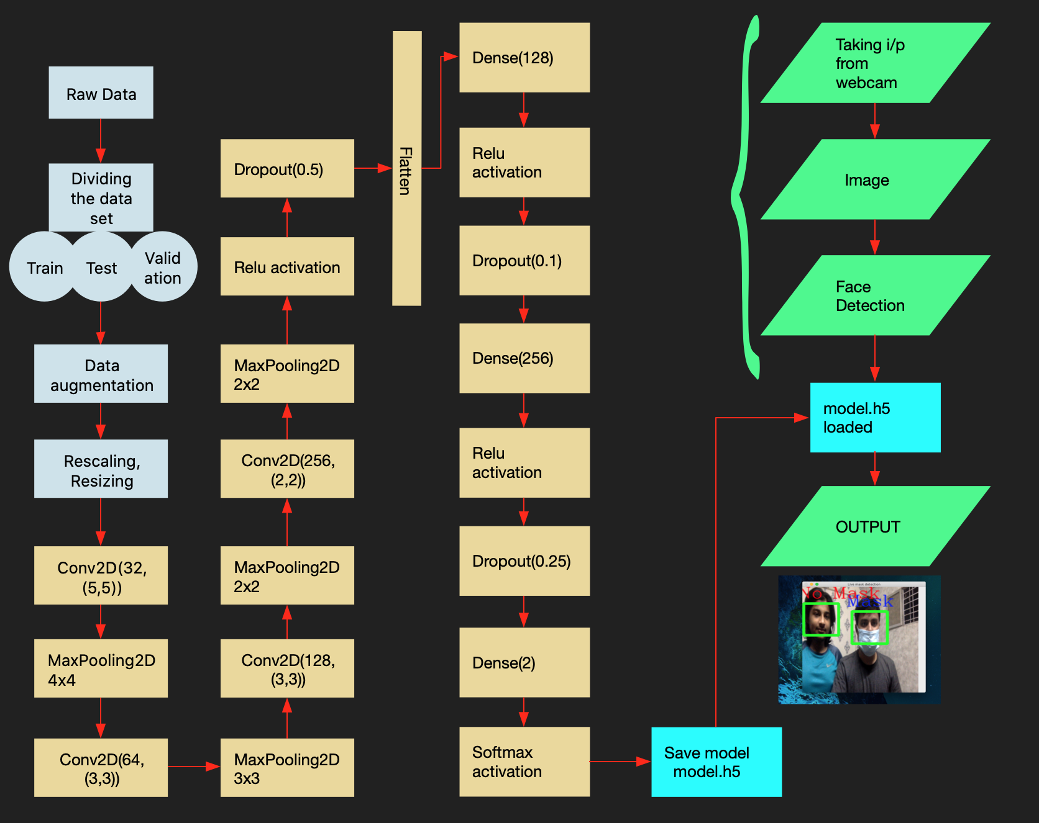
Our Model

Slide 15
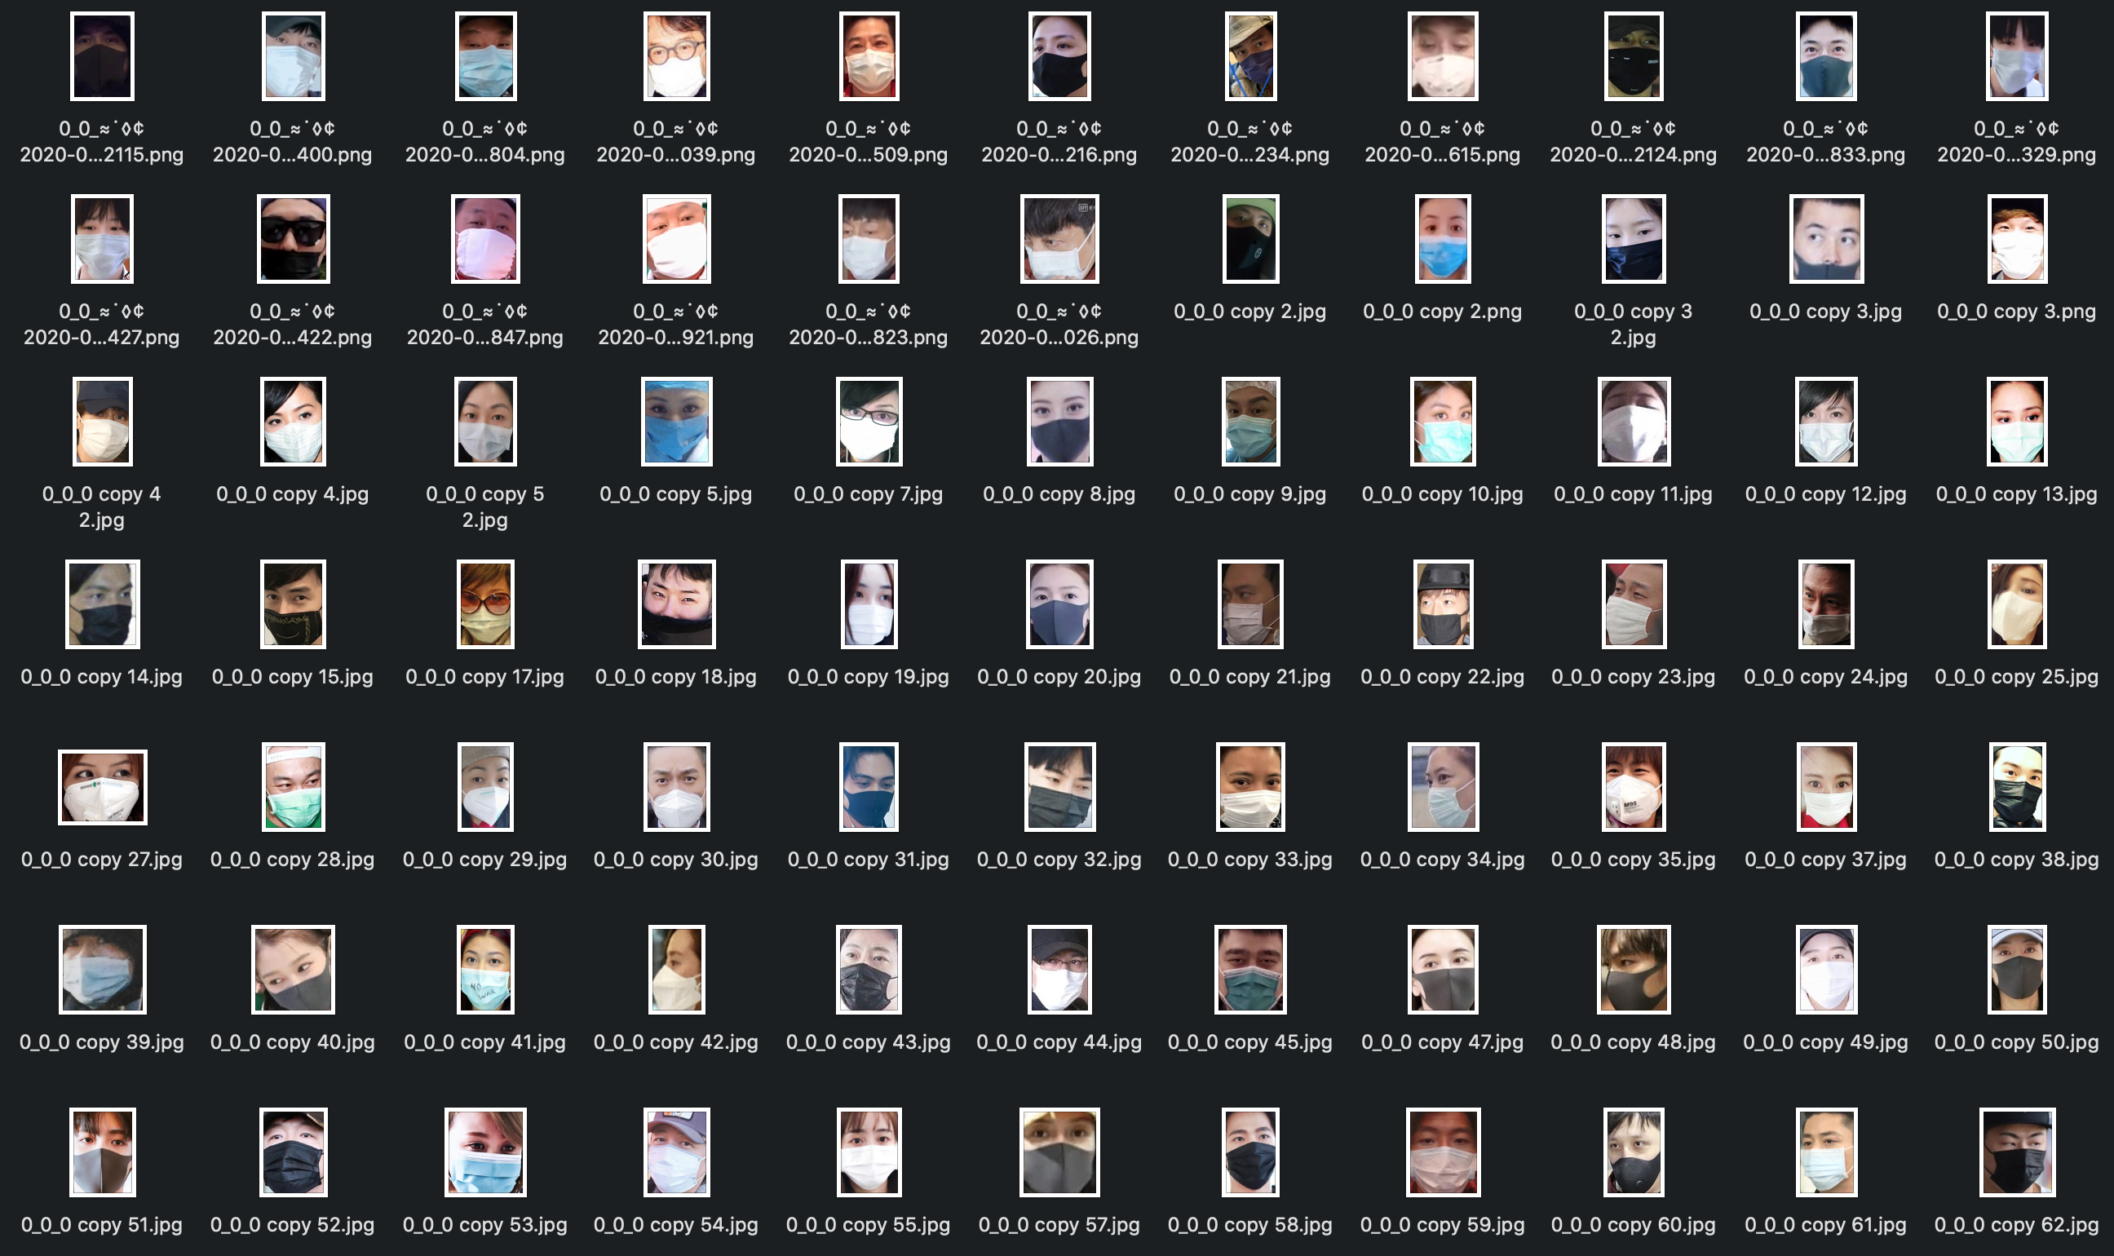
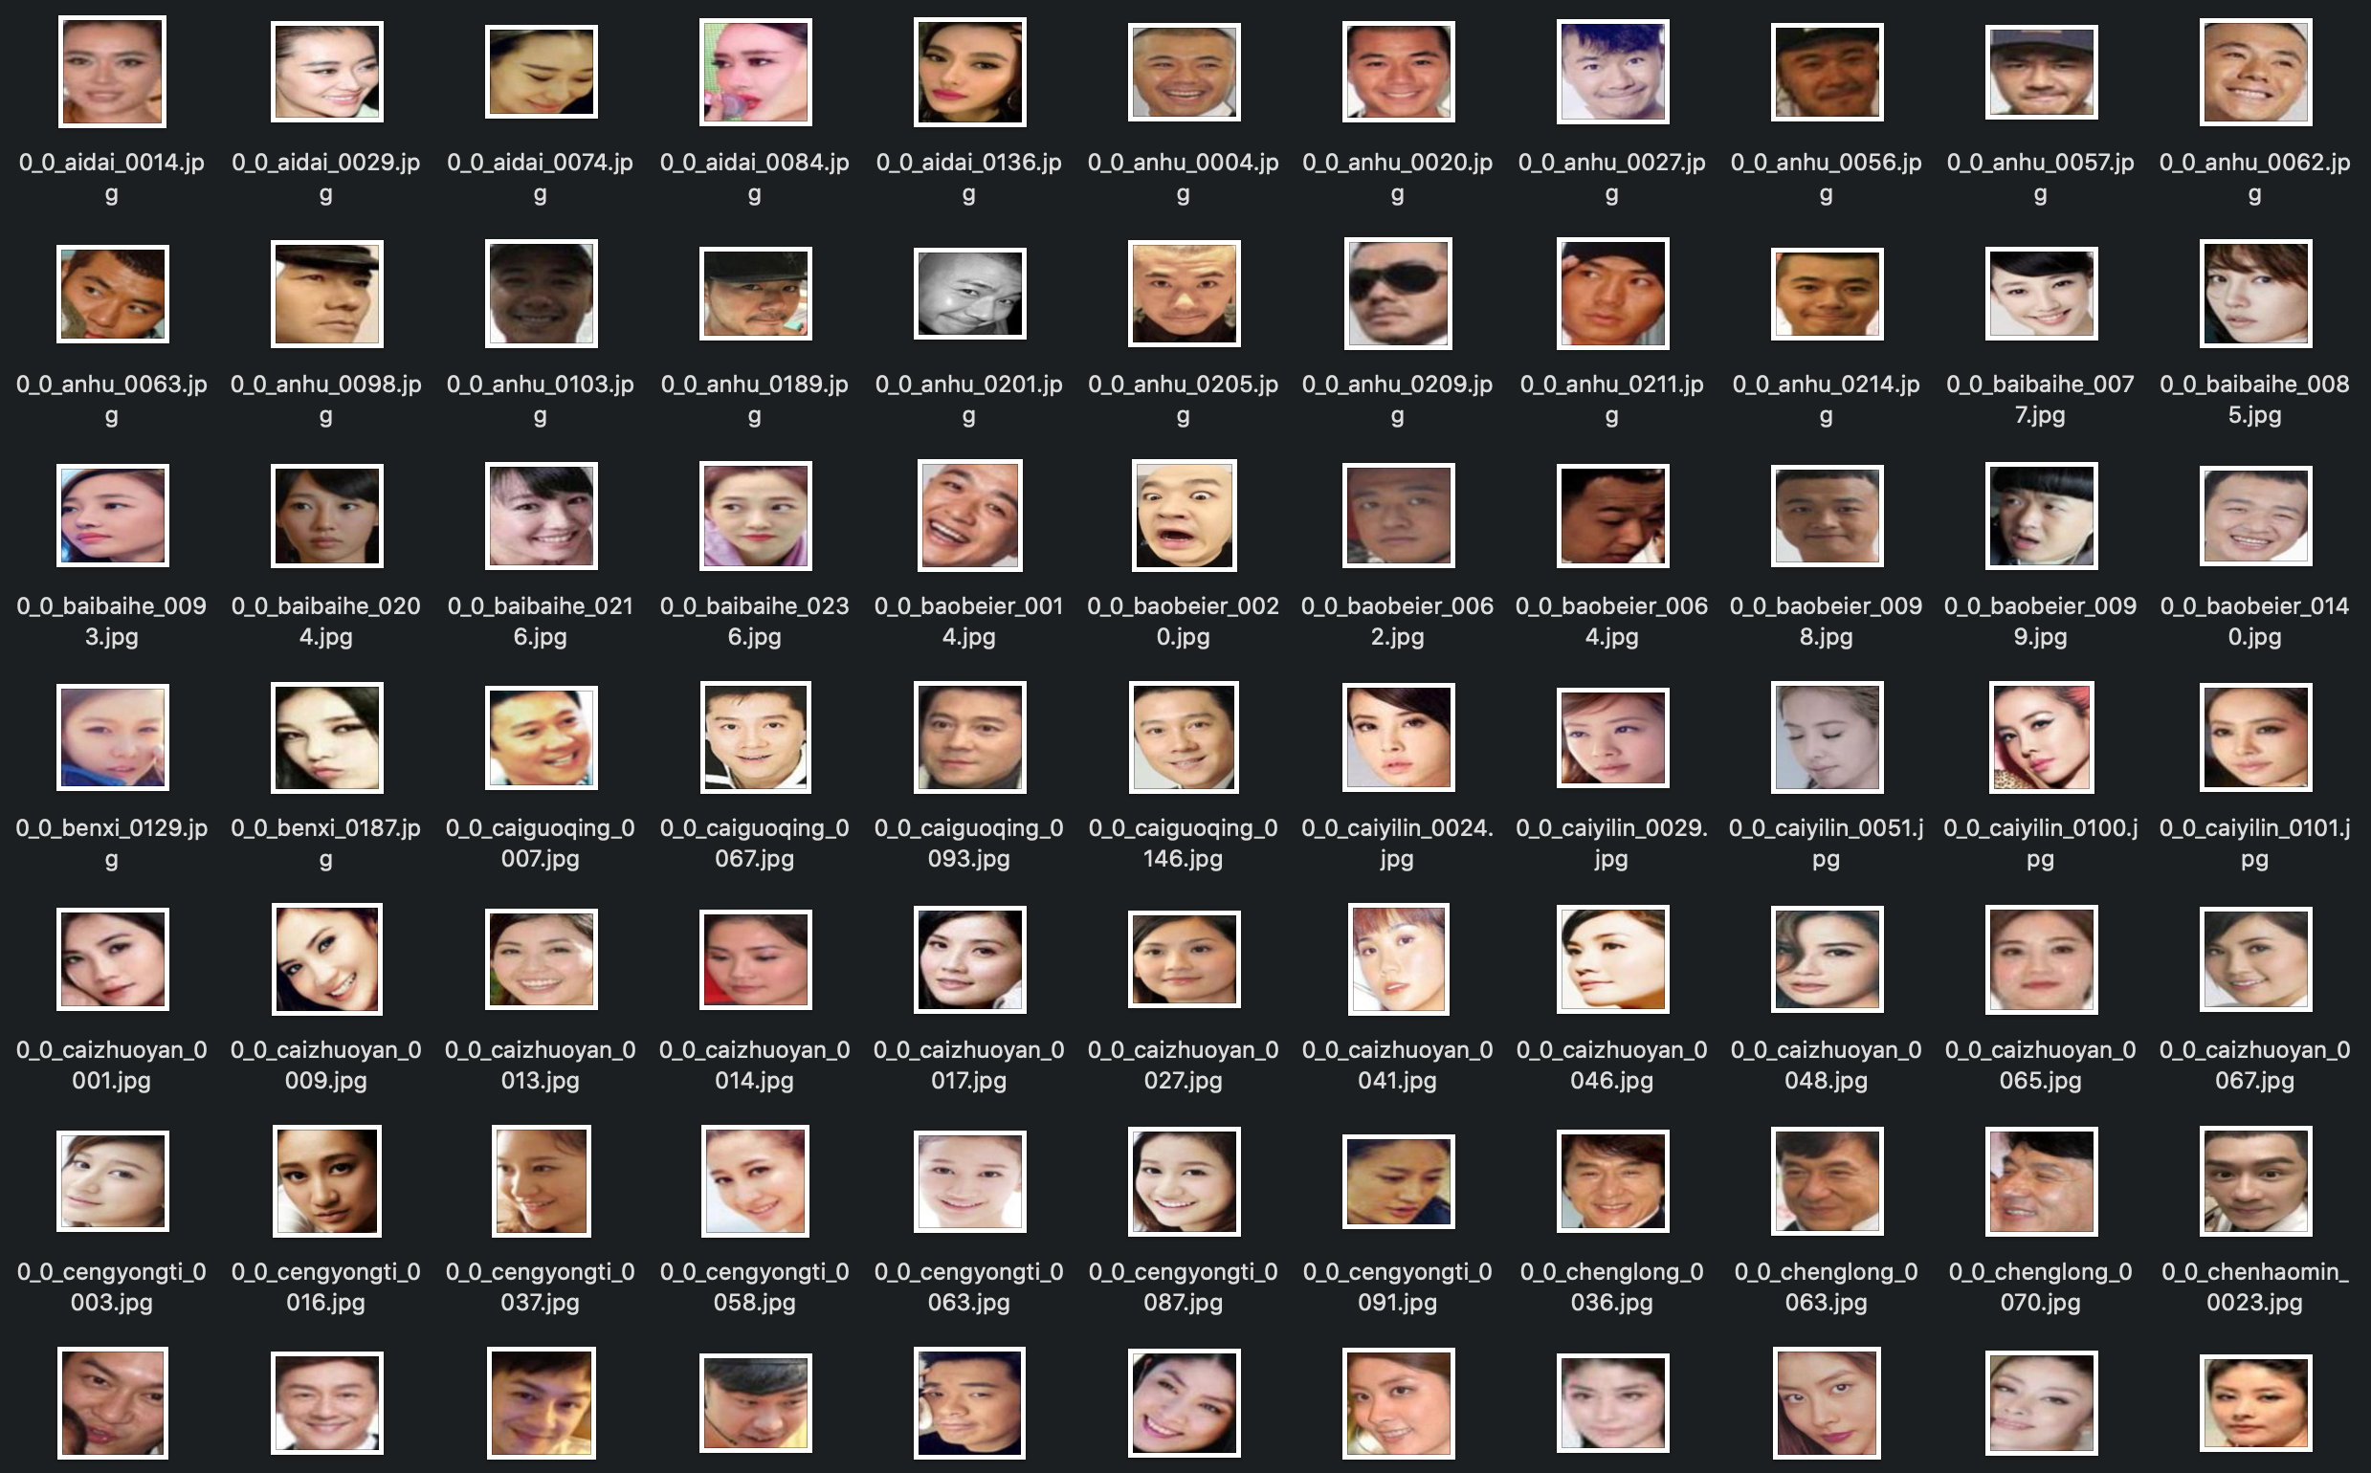
Dataset
The dataset consist of 1500 masked and 1500 non masked faces.
We need to split the data into training, testing and validation sets for our implementation.

Slide 16
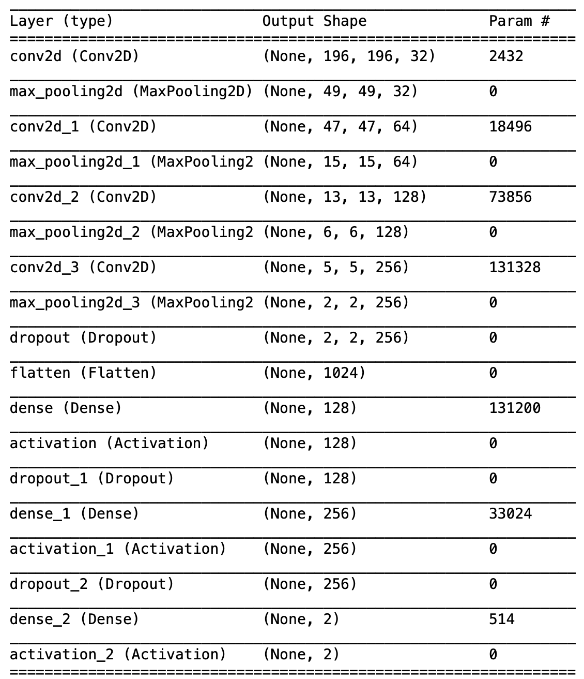
CNN Architecture Summary

Slide 17
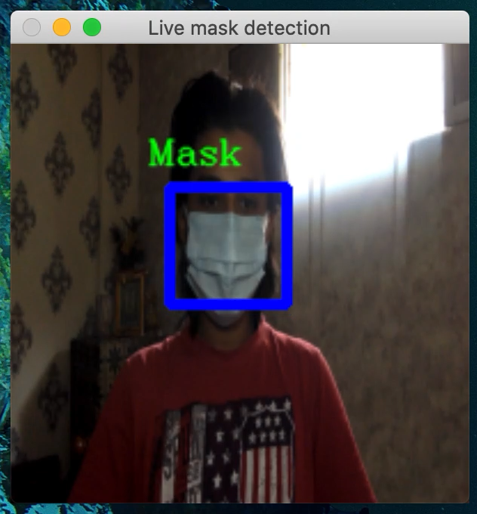
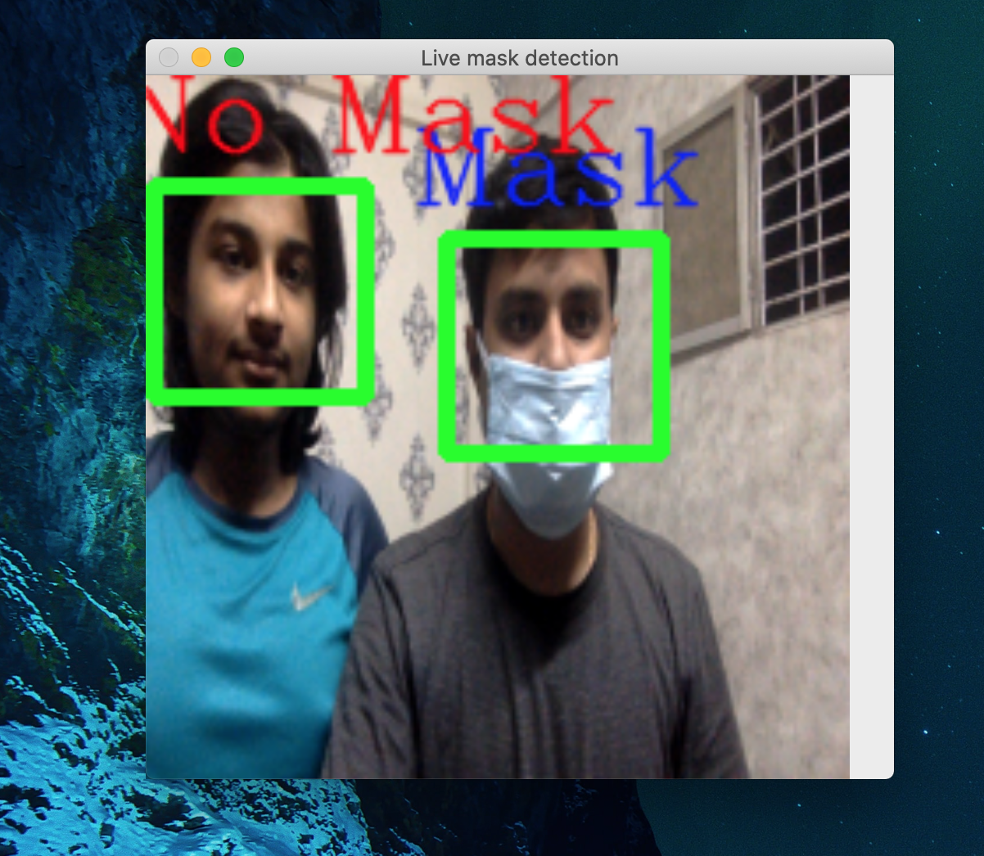
Output

Slide 18
Thank You

